Slide 1
Agricultural Information Providing Smart Phone Application: Friends For Farmers App
Project Proposal
by
1) Manisha Inchanalkar
2) Aditi Bane
3) Mayuri Inchanalkar
4) Pradnya Panchariya

Slide 2
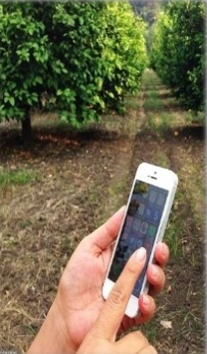
Introduction
Real benefits of E-commerce have not reached to the villagers especially to the farmers community.
Exchanges for various commodities have been offered through digital platforms for meeting the needs. Friends for Farmer is a free mobile app which acts as an online market for crop market. It is a one-stop marketplace that is open to all buy or sell crops across India.
Proposed project will help the farmers to sell their product and the customers to buy those products online with the help of our appss.

Slide 3
Problem Definition
e-Marketing platforms will reduce the role of middlemen who are hindering the trading sector in the agriculture. This e-Marketing app is free of cost and can be accessed from anywhere and made available to farmers.
While trading farm produces, this is an Online Marketplace that comes into action which allows users to buy and sell crops.
Farmers can post their products and attract more buyers which will save precious time and money. They can get better profits than normal. According to the market prices, the product entries can be removed or re-activated by the users. As the app reduce middleman buyers and sellers can privately chat to negotiate prices safely.

Slide 4
Objectives
Friends For Farmers is a free mobile application which is targeted for agriculture practitioners, which provides a platform where app connects and brings together the farming community and helps them in selling, buying and exchanging agriculture commodities and services locally without middlemen through an Add/listing which they can post right from their mobile.
This app enables the seller or buyer can chat with each other and the details can be shared by messaging and then discuss the deal on phone contact.
This is a user-friendly app where the farmer can post anything related to his products in one minute. Just enter the details of the product, click Submit and instantly farmer’s product will be displayed.

Slide 5



App Working- Flow Chart
Start the app
Farmer
Customer
Register
Add Product
Product Name
Quantity
Price
Number of farmer whose Product you Want to Buy
Click on save option and save the data
Enter product name and quantity and your contact Numbers
Get ordered
Order placed

Slide 6
Watch a Demo in the Following Slides

Slide 7
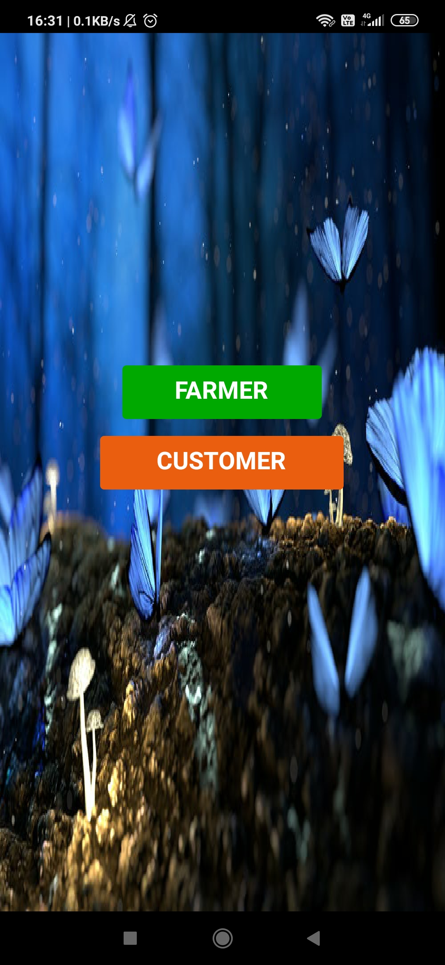
When you initiate the app, the first thing you encounter are two buttons: Farmer and Customer. Click on the Farmer button.

Slide 8
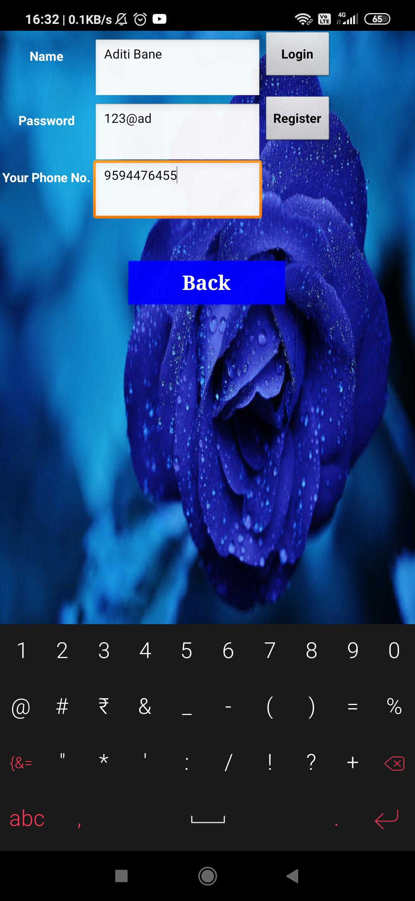
Then, enter you details such as name, password and phone number and click on register button.

Slide 9
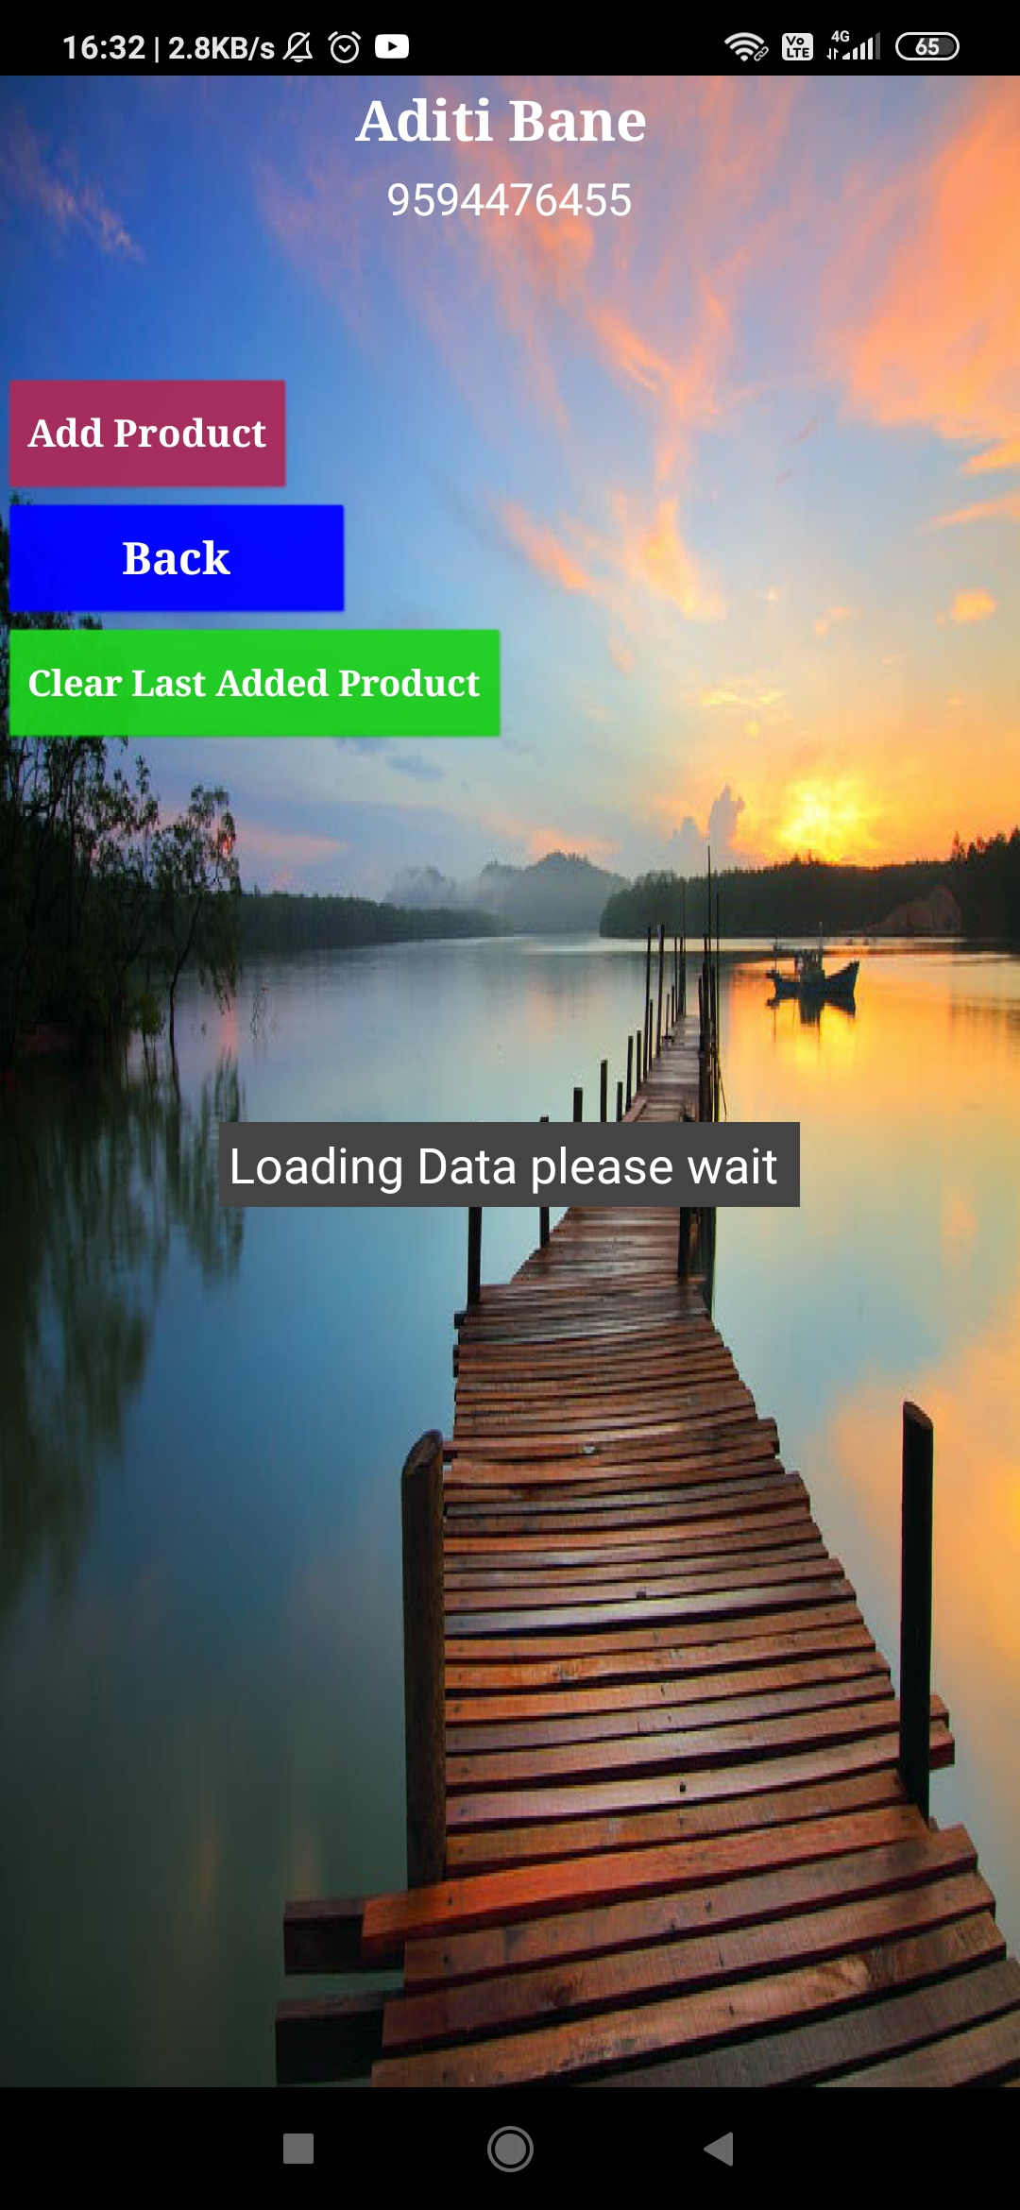
It will take a few seconds to load your data.

Slide 10
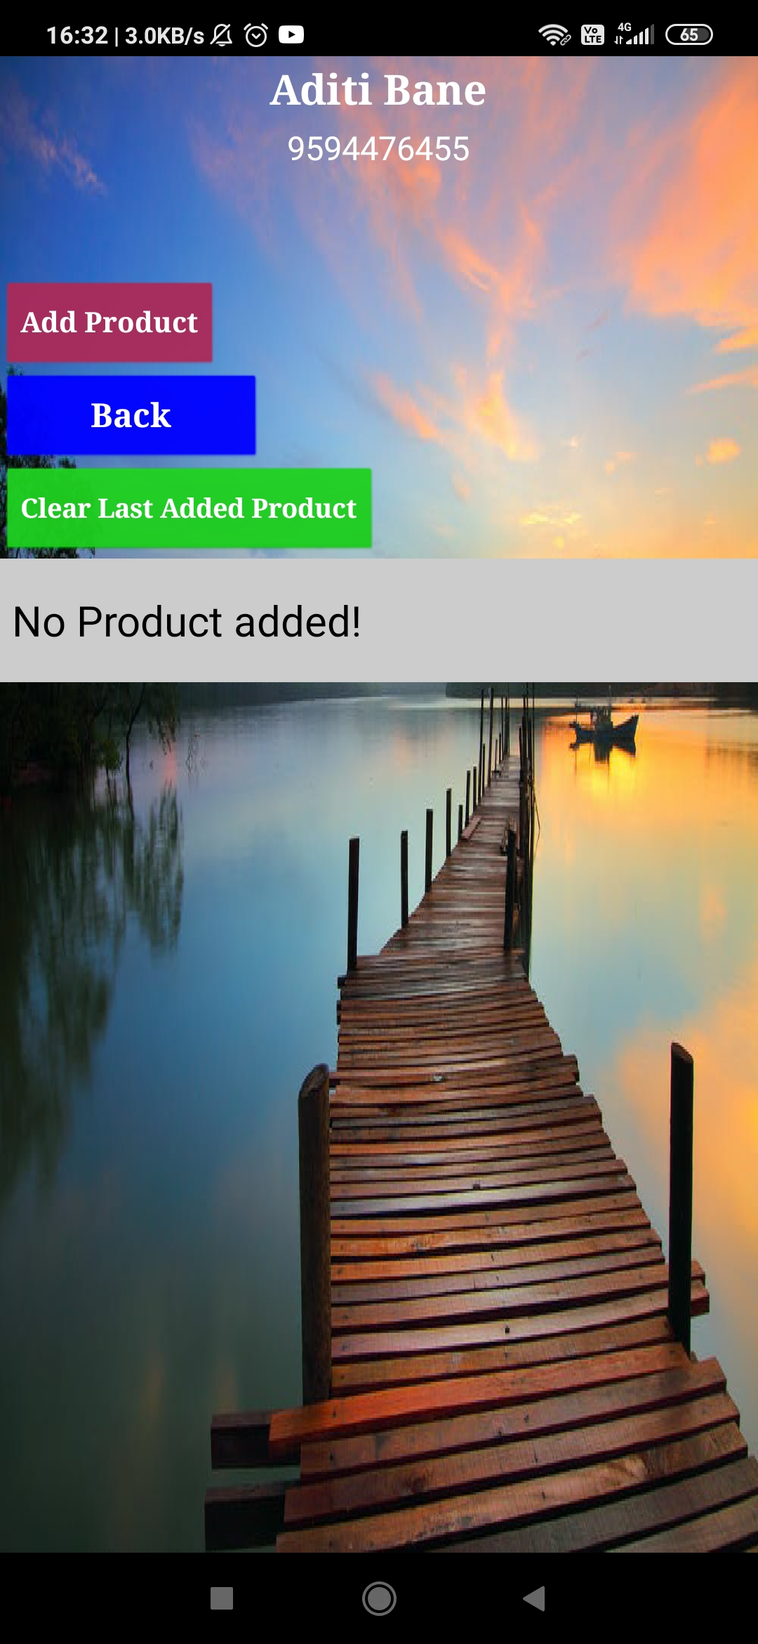
Here as you can see, no products have been added. Now let’s click on the ‘Add Product’ button to add new products for the farmer.

Slide 11
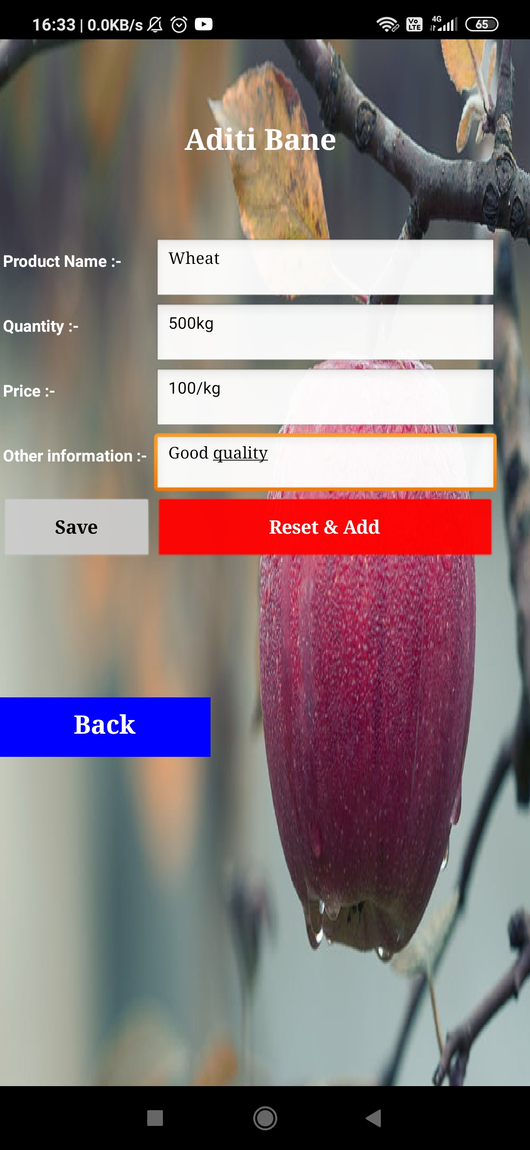
Now, you have to enter your product details such as product name, quantity, price and other information. Then click on save.

Slide 12
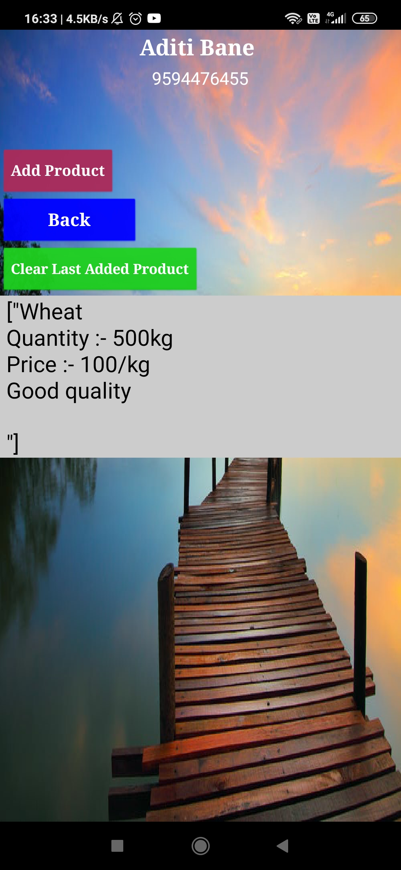
After adding you product details, you can click back and see whether your product is displayed in your profile.

Slide 13
Now, click on the customer button.

Slide 14
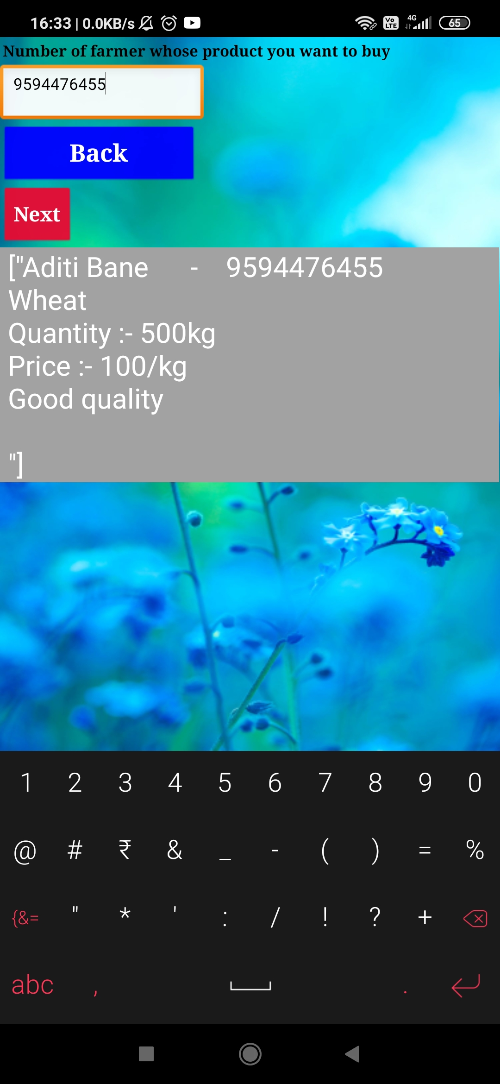
You will be able to view all the products details and the farmer’s name and contact details. After entering the contact number of the farmer, click on next.

Slide 15
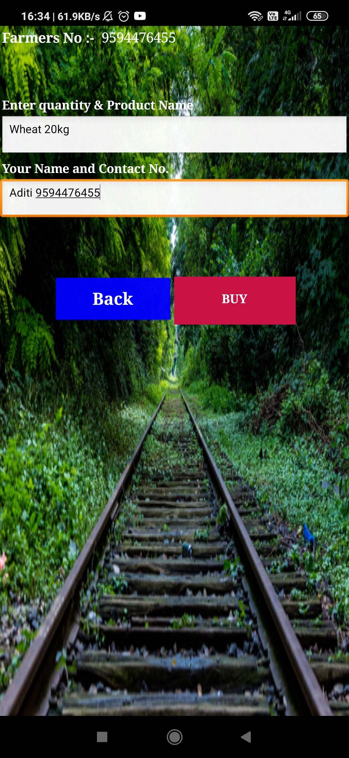
Now, enter the quantity and product name that you want to purchase. After that enter your name and contact number. Click on buy to proceed further.

Slide 16
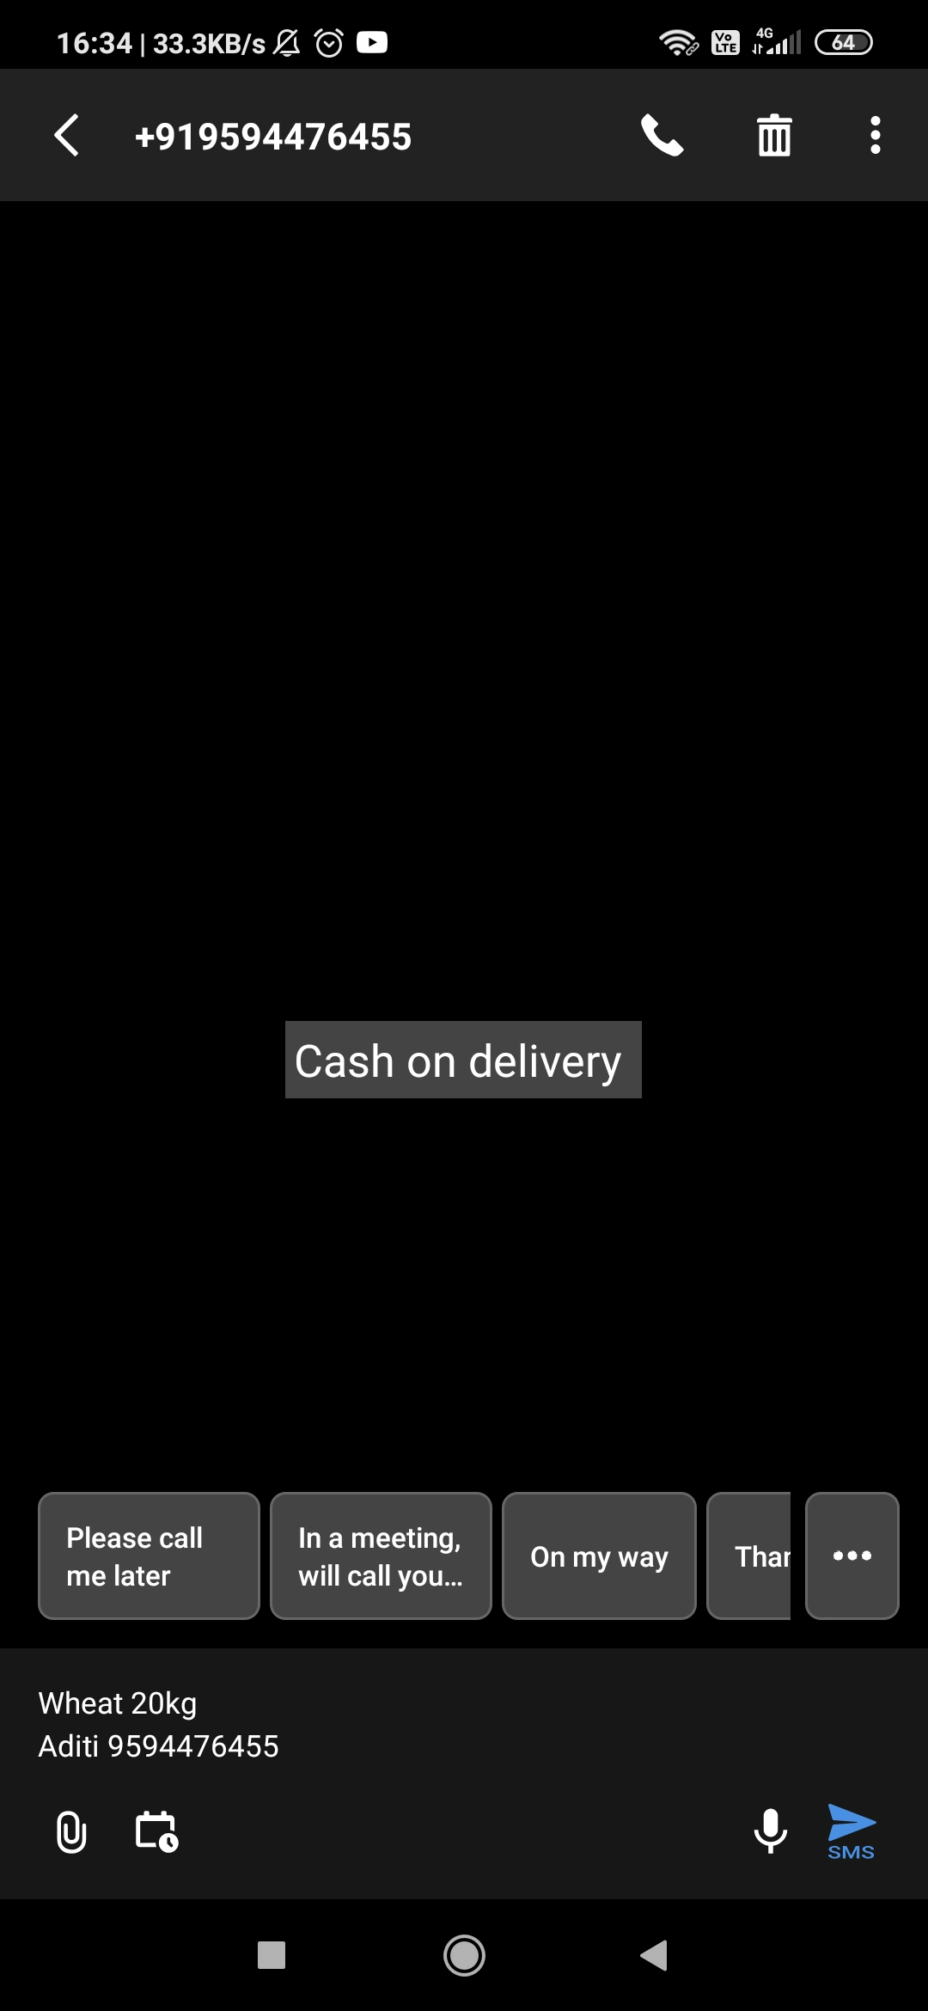
Then, you will be redirected to inbox with a message to the farmer’s contact number where you can see your purchase details.

Slide 17
Link for the project: https://github.com/aditibane/Friends-for-Farmers-App Link for the demo video: https://drive.google.com/drive/u/0/folders/1ZHtBPPKnwyfZ__1aNfiDIpSKrtSmrqgL

Slide 18
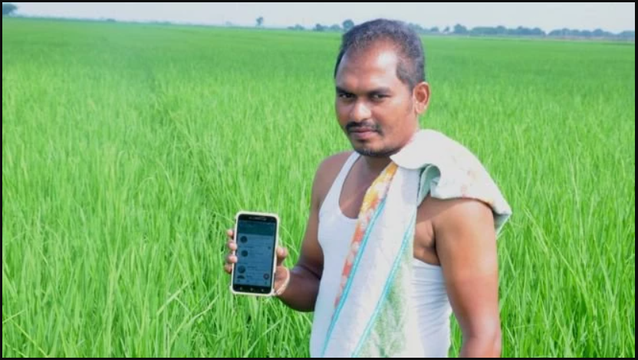
THANK YOU

